Slide 1
ADVANCED MARKETS
ADVANCED MARKETS
PETE LEE, RICP®
DIRECTOR OF ADVANCED MARKETS
BILL MARTIN 2.0
DIRECTOR OF MARKETING
For Agent Use Only – Not For Use With The Public

Slide 2
ADVANCED MARKETS
MISSION:
To give you the Tools, Training and Support needed to expand your business and provide your clients with safe savings and protection solutions that utilize:
INDEXED
ANNUITIES
LIVING
BENEFITS
INDEXED UL

Slide 3
(Indexed Product and Living Benefit Marketing QuickStart Meeting)
RALEIGH
NASHVILLE
ORLANDO
COLUMBUS
SEATTLE
APRIL 12TH
APRIL 26TH
MAY 3RD
MAY 24TH
JUNE 21ST

Slide 4
REGISTER FOR SUMMER CONVENTION
TODAY!

Slide 5
IUL – Tax-Free Retirement & College Planning

Slide 6
Our Why Began 170 Years Ago
OCTOBER 5 Independent Life Distribution Turns 20
NOVEMBER 13 National Life Turns 170
Notes:
20 years ago, IND life closed the year with just over 300,000 in Life WNAP (309,827)
10 years ago IND life was 57.5 million

Slide 7
And this year, we celebrate 2017’s historic financials
$241MM Life WNAP
… and experiencing record breaking growth.
Up
24%
over 2016
$142MM Annuity Flow
Up
8%
over 2016
$737MM SPDA Premium
Up
5%
over 2016
Notes:
155MM of annuity flow includes National Life and SAVA

Slide 8
And this year, we celebrate 2017’s historic financials
381,641 Annuity Customers Served
We’re protecting more of Main Street than ever before…
Up
7.5%%
over 2016
401,421 Life Customers Served
Up
9.1%
over 2016
$2.1B Total Benefits Paid = Promises Kept
Notes:
------ NOTES –-----
We have 783,062 customers to date – 33K added in the last 6 months of 2017

Slide 9
Continuing to Stand Out in a Sea of Sameness
#1
Provider of Indexed Annuities in Employer Plans and Longest Standing Issuer*
#3 in IUL
#16 in Life Companies
162 Years of Paid Dividends
* #1 Provider - LIMRA US Individual Annuity Industry Sales Report, 2Q2017; Longest standing issuer - Insurance News Net, FIAs at Age 20, 2015
TC#99089(0118)
For Agent
Notes:
As of the end of third quarter year-to-date we were ranked 17th in life sales in the 3Q2017 LIMRA US Retail Individual Life Insurance Sales Report. (this is individual life sales)
According to Wink’s Sales and Market Report 3rd Quarter 2017 National Life Group was the #3 carrier as of the end of 2013, 2014, 2015, and 2016.
According to the same report we have been in the top 5 since 2006.
We’re a pioneer in Living Benefits and first used the phrase in 1937 in a Saturday Evening Post ad.
As you know we are turning 170 this year, which means we began paying dividends when we were 8 years old.
NOTE: New ranking from LIMRA will be available in February

Slide 10
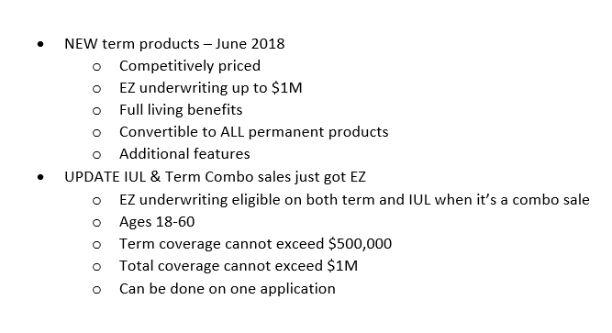
Updates

Slide 11
Why National Life?
100 MILLION adults do not have life insurance
170M
70 MILLION adults are under insured
DON’T HAVE ENOUGH LIFE INSURANCE
2015 LIMRA Insurance Barometer Study
Notes:
So why is it important to offer life insurance protection to your clients?
100 million adults do not have life insurance while 70 million are underinsured.
A permanent life insurance policy with Living Benefits helps to protect a home, family and income in the case of premature death, or the financial devastation from a terminal, chronic, or critical illness.

Slide 12
CONSUMER FINANCIAL CONCERNS
Notes:
On Main Street, we understand life happens. Life insurance is a powerful financial tool that can be used to protect and secure a family’s future should you die too soon. Our optional accelerated benefits riders provide access to the death benefit while you are still alive, helping you cover the costs of a qualifying terminal illness, chronic illness, critical illness or critical injury. National Life Group exists to help solve life’s puzzles. Our vision is to provide peace of mind whether you Die Too Soon, Become Ill, or Live Too Long. Caring, Planning, and Protecting what matters most. When it comes to figuring out life’s puzzles…we’re here to help!

Slide 13
TERMINAL ILLNESS

Diagnosed with a terminal illness expected to result in death within 24 months

No waiting period

Lump sum distribution (discounted from death benefit)

Funds can be used at the policyholder’s discretion

Maximum lifetime benefit payable under all ABR’s $1,500,000
Notes:
In order to qualify for the Terminal Illness rider, a diagnosis of a terminal illness resulting in death within the next 24 months must be made. The 24 month life expectancy makes National Life very competitive but some states require a 12 month life expectancy so please check the ABR Agent Guide for state specials.
The client can accelerate all or a portion of the discounted death benefit which is received in a lump sum.

Slide 14
CHRONIC ILLNESS
Unable to perform two of six Activities of Daily Living or cognitive impairment
ACTIVITIES OF DAILY LIVING
COGNITIVE IMPAIRMENT
Bathing
Continence
Dressing
Eating
Toileting
Transferring
Required substantial supervision to protect oneself from threats to health and safety due to severe cognitive impairment
Short term or long term memory impairment
Loss of orientation to people, places or time
Deductive or abstract reasoning impairment
Notes:
Unable to perform two of six Activities of Daily Living or cognitive impairment
Activities of Daily Living
Bathing
Continence
Dressing
Eating
Toileting
Transferring
Cognitive Impairment
Required substantial supervision to protect oneself from threats to health and safety due to severe cognitive impairment
Short term or long term memory impairment
Loss of orientation to people, places or time
Deductive or abstract reasoning impairment

Slide 15
CHRONIC ILLNESS

Chronic Illness is calculated as 2% of the discounted net death benefit each month or 24% annually (not to exceed the IRS annual per diem).

The rider needs to be in force for 2 Years in order to accelerate

Funds can be used at the policyholders discretion (with state exceptions)

Maximum lifetime benefit payable under all ABR’s is $1,500,000
Notes:
Chronic Illness is calculated as a 2% of the discounted net death benefit each month or 24% annually (not to exceed the IRS annual per diem).
Waiting period of 90 days applies – check ABR Agent Guide for state specials
Maximum lifetime benefit payable under all ABR’s is $1,500,000

Slide 16
CRITICAL ILLNESS
QUALIFYING CONDITIONS
SEVERITY LEVELS
ALS (Lou Gehrig’s disease)
Blindness
Cancer
End Stage Renal Failure
Heart Attack
Major Organ Transplant
Stroke
Minor
Moderate
Severe
Life Threatening
Notes:
To qualify for Critical Illness, the insured must have or have had one of the conditions listed which as you know has recently expanded, we will review the additional conditions later. These are also available for state specials.
A severity level will be assigned from minor to life threatening looking at the condition and future mortality. The least payout will occur under minor as a qualifying event that is determined to be minor would have had the least impact to future mortality – in simpler words – we do not expect your death to be imminent because of the qualifying condition. The greatest payout will occur under life threatening as under that situation, your future mortality is greatly impacted because of the qualifying condition – in simpler words – we would expect your death to happen much sooner as a result of the qualifying condition. To qualify for Critical Illness, the insured must have or have had one of the conditions listed.

Slide 17
BUT WAIT…THERES MORE!
CRITICAL ILLNESS
CRITICAL INJURY
EXISTING
NEW
Coma
Paralysis
Severe Burns
Traumatic Brain Injury
Blindness
Cancer
Diagnosis of ALS
End Stage Renal Failure
Heart Attack
Major Organ Transplant
Stroke
Aorta Graft Surgery
Aplastic Anemia
Cystic Fibrosis
Heart Valve Replacement
Motor Neuron disease
Sudden Cardiac Arrest
Notes:
But wait there’s more
Critical illness yesterday
Existing
Blindness
Cancer Diagnosis of ALS
End Stage Renal Failure
Heart Attack
Major Organ Transplant
Stroke
And today…
New
Aorta Graft Surgery
Aplastic Anemia
Cystic Fibrosis
Heart Valve Replacement
Motor Neuron disease
Sudden Cardiac Arrest
13 events now qualify
But we believe even more is even better so as you heard, we have now added 4 qualifying critical injuries
Coma
Paralysis
Severe Burns
Traumatic Brain Injury
We have once again put ourselves in the position of being THE leader in providing Living Benefits to clients

Slide 18
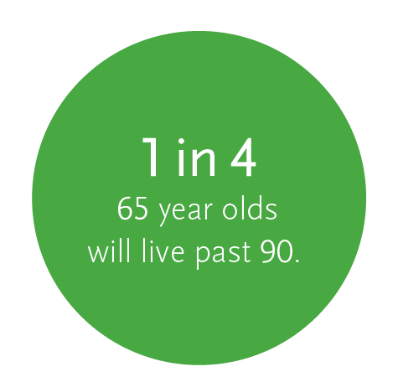
FlexLife II
Death benefit to protect loved ones from financial uncertainty
Potential for cash value accumulation
NEVER exposes premium dollars to market risk
Potential for guaranteed income for life
Living benefits in the event of a qualifying terminal, chronic, critical illness or critical injury
3
1
2
1 National Health Interview Survey, 2012
2 2015 Life Insurance Barometer Study
3 LaCanfora, M. (2010 July 15)
Notes:
FlexLife II offers all the advantages of FlexLife [read from slide] with some exciting new enhancements

Slide 19
EZ Underwriting
New Program
Ages 18 – 60 - up to and including $1,000,000 Face Amount
Ages 61 – 65 – up to and including $250,000 Face Amount
Full underwriting for higher face amounts
Complete Part II medical on application
Through use of new tools, decisions can often be made without invasive underwriting requirements.
If certain criteria are met, case will be issued immediately without the need for exams or labs

Slide 20
Field Underwriting Resources
There is a variety of helpful tools and resources available to help you with field underwriting
Pre-screen your clients before you take an app…be prepared before you sit down!
Google medications and medical conditions
MedicineNet.com, mayoclinic.org
Submit a quick quote: underwritingquotes@nationallife.com
Life Insurance Underwriting Guide
Call an underwriter, we’re happy to help!
3
1
2

Slide 21
Quick Quote Template
underwritingquotes@nationallife.com
Age/DOB, gender
Height & weight
Tobacco use status (past & present)
Plan/amount/riders to be considered
Medical diagnosis
Date of diagnosis
Treatment and medications
Severity of condition, prognosis, any restrictions
Any other pertinent details for each condition
3
1
2

Slide 22
Hints and Tips - Recap
You’ve done so much work already to get the customer, make sure you work just as hard at the field underwriting so you have the best chance of turning your customer into a policyholder!
Prescreen and quote your client appropriately based on the information presented. We don’t want you to have to sell the case twice!
Keep up the good work!
3
1
2

Slide 23
FlexLife II Highlights
4 Living Benefit Riders – Terminal, Chronic, Critical Illness, Critical Injury – 20 triggers
Guaranteed Income Rider – LIBR (Plus fixed loans, participating variable and participating fixed with a cap of 5%)
EZ Underwriting up to $1M
Charitable Matching Death Benefit Rider – 2% of death benefit up to $30,000
Benefit Distribution Option – elect death benefit as income stream
Balance Sheet Benefit Rider – early cash value rider, can waive up to 100% of surrender charges
Persistency bonus beginning in year 11 – can earn up to 10% on interest credited up to .60% of accumulated value. Formula is guaranteed

Slide 24
Tax-Free Retirement Strategy

Slide 25
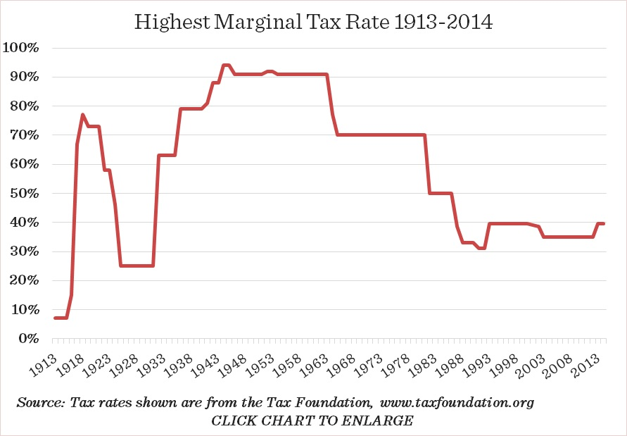
WHAT DIRECTION DO YOU THINK FUTURE TAX RATES ARE GOING TO GO?
Notes:
As can be seen from this historical tax-rate chart, we are currently in one of the lowest income tax environments in our history.
So what direction do you think tax rates are going to go?

Slide 26
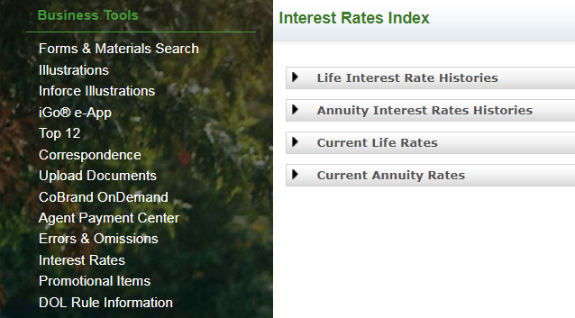
A STRONG HISTORY

Slide 27
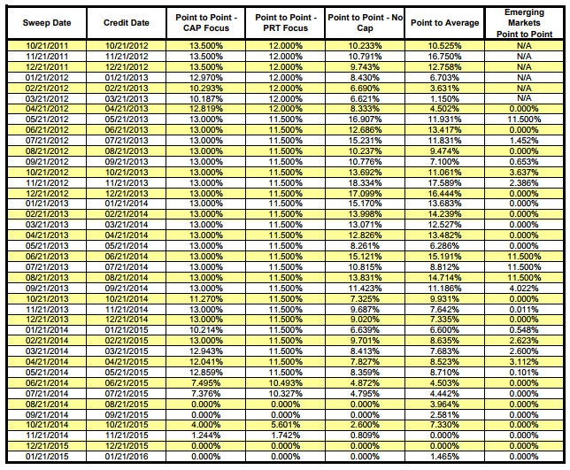
A STRONG HISTORY

Slide 28
TFR Strategy Example
Retirement Planning
40 Year old male – Preferred NT
Contribute $500 per month through age 67
Retire at age 68 and start income
7% interest rate
6% VLR

Slide 29
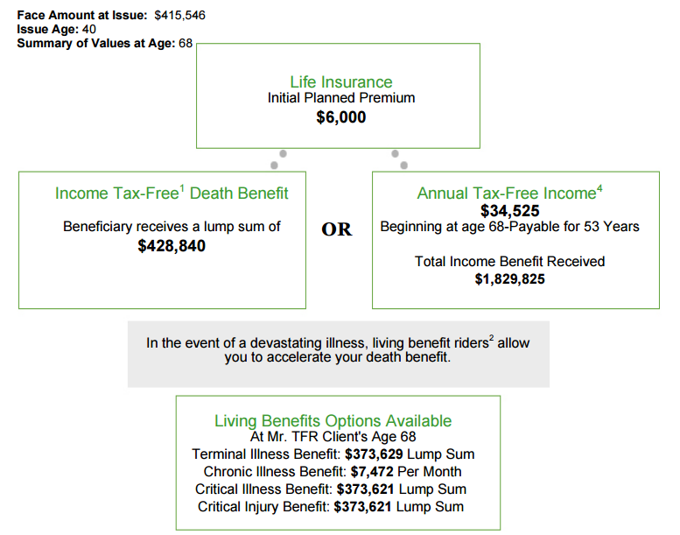
Retirement Planning
Total Contributions: $162,000
Total tax-free income through age 100: $1,139,325

Slide 30
TFR Strategy PDA Example
Retirement Planning
50 Year old female – Standard NT
Has lump sum of $100,000
Use Premium Deposit Account (PDA) to fund over five years
PDA payout = $20,600 years 1-5
Contribute an additional $5,000/year every year until age 70
Retire at age 70
7% interest rate
6% VLR

Slide 31
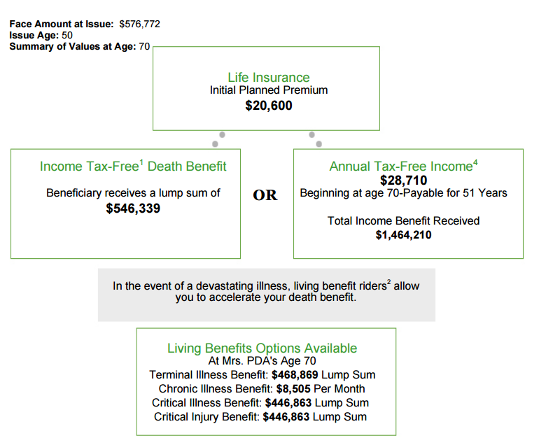
Retirement Planning
Total Contributions: $175,000
Total tax-free income through age 100:
$861,300

Slide 33
College Planning

Slide 34
College Planning

Slide 35
College Funding Example
College Planning
1 year old male
Parents would like to contribute $150 per month
$$$ out to repay student loans age 22 through age 25
Continue funding after college (adult child) $150 per month
$$$ for retirement at age 70
7% interest rate
Option B increasing death benefit
6% VLR

Slide 36
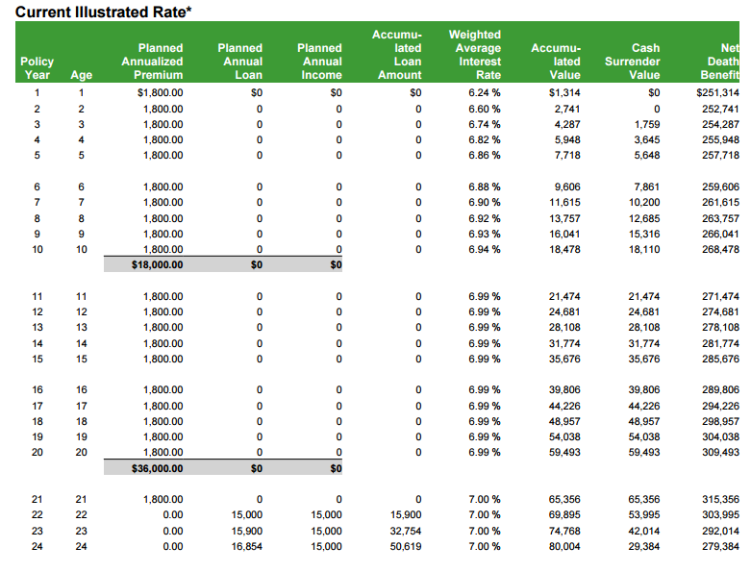
College Planning
Tax-free $$$ at age 22:
$15,000/yr for 4 years
Total for college: $60,000

Slide 37
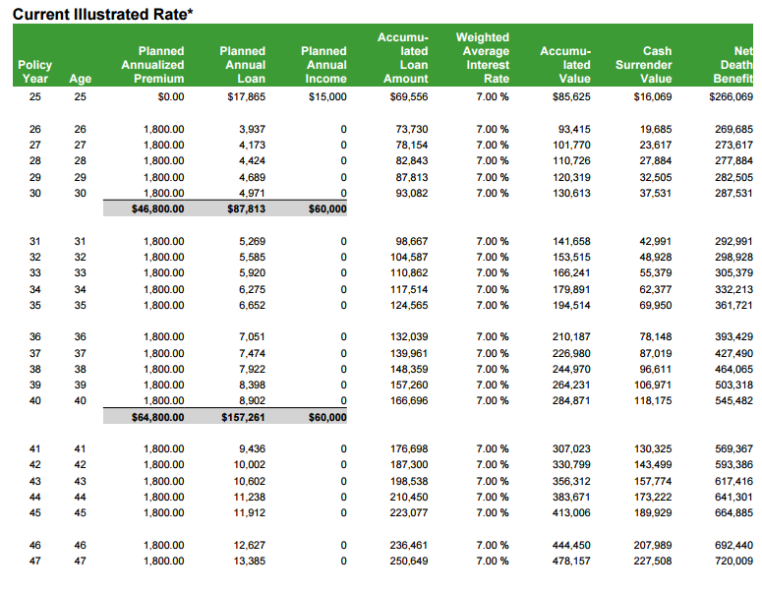
College Planning
After college adult child continues funding: $150 per month

Slide 38
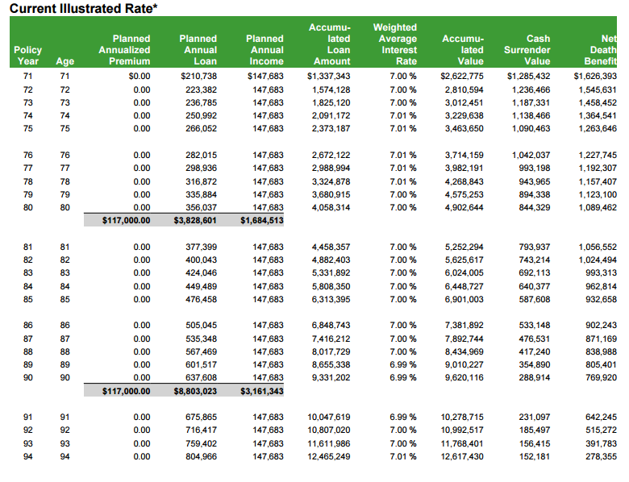
College Planning
Tax-free income at
age 70=
$147,683 per year

Slide 39
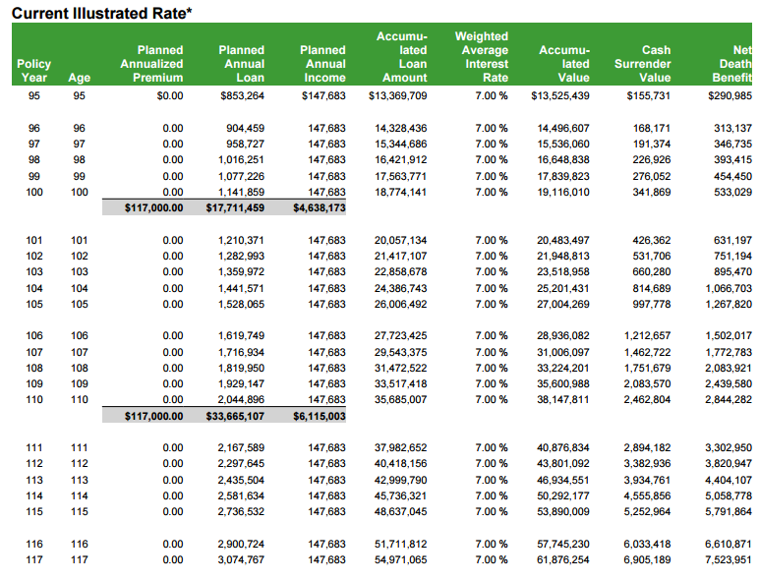
College Planning
Tax-free projected income through age 100:
$4,638,173!
**Assuming 7% average rate of return**

Slide 40
Term Insurance
10 year
15 year
20 year
30 year

Slide 41
LSW Term – Conversion Privilege
Full Commission on
Conversions.
Full suite of permanent
products available.
10 Years on 10 Year Term
12 Years on 15 Year Term
15 Years on 20 Year Term
20 Years on 30 Year Term
Not beyond age 70
Ages 66 and higher – 5 years
Notes:
One of the strongest competitive advantages of our term products is the ability to convert to our full suite of permanent products – this is not necessarily the case with many of our competitors.
This chart shows the new conversion periods for the different term products and note that no conversions are allowed after age 70. For issue ages 66 and higher the maximum conversion period is 5 years.

Slide 42
Term IUL Combo sale update
If your client qualifies for EZ underwriting, the underwriter will waive the exam and labs on the term provided the cases fall within the following parameters:
– Applicant age 18-60 – Maximum Term coverage $500,000 – Total combination sale amount not to exceed $1,000,000 – Proposed insured will not exceed NLG’s current lifetime non-med limits of $1,000,000

Slide 43
Your Sales & Marketing Support
Jessica Myers, MBA, CLU® Key Accounts – Independent Distribution JMyers@NationalLife.com 802-249-6298 (cell)
Mike Beaulieu Key Accounts – Independent Distribution MichaelB@NationalLife.com 802-522-5275 (cell)
Jake Peck, Internal Sales Associate
JPeck@NationalLife.com
802-229-3920
SALES DESK: 800-906-3310

Slide 44
Pete Lee
Director of Advanced Markets
plee@equisfinancial.com
904.234.1795
Bill Martin 2.0
Director of Marketing
wmartin@equisfinancial.com
828.299.9600 x 601

