Slide 1

ADVANCED MARKETS
ADVANCED MARKETS
PETE LEE, RICP®
DIRECTOR OF ADVANCED MARKETS
BILL MARTIN 2.0
DIRECTOR OF MARKETING
For Agent Use Only – Not For Use With The Public

Slide 2
ADVANCED MARKETS
MISSION:
To give you the Tools, Training and Support needed to expand your business and provide your clients with safe savings and protection solutions that utilize:
INDEXED
ANNUITIES
LIVING
BENEFITS
INDEXED UL

Slide 3


(Indexed Product and Living Benefit Marketing QuickStart Meeting)
RALEIGH
NASHVILLE
ORLANDO
COLUMBUS
SEATTLE
APRIL 12TH
APRIL 26TH
MAY 3RD
MAY 24TH
JUNE 21ST

Slide 4

REGISTER FOR SUMMER CONVENTION
TODAY!

Slide 5
LIFE EVENTS
Life Insurance you don’t have to die to use
TC89485(0316)1

Slide 6
WHAT CAN HAPPEN?
25%
of mortgage foreclosures are the result of financial hardship due to a health crisis¹
57%
of bankruptcies are due to a critical illness.²
+
Nursing Home Cost for Private Room:
For nursing home care, the national monthly average is now $7,604, which translates into $91,250 annually.³
1 Current FDIC Stats, https://www.fdic.gov/about/comein/files/foreclosure_statistics.pdf;
2 “NerdWallet Health finds Medical Bankruptcy accounts for majority of personal bankruptcies“, March, 2014
3 Cost of Care Maps Genworth 2015 Cost of Care Survey - 2015
Notes:
Bankruptcies - http://www.nerdwallet.com/blog/health/2014/03/26/medical-bankruptcy/

Slide 7



CONSUMER FINANCIAL CONCERNS
Notes:
On Main Street, we understand life happens. Life insurance is a powerful financial tool that can be used to protect and secure a family’s future should you die too soon. Our optional accelerated benefits riders provide access to the death benefit while you are still alive, helping you cover the costs of a qualifying terminal illness, chronic illness, critical illness or critical injury. National Life Group exists to help solve life’s puzzles. Our vision is to provide peace of mind whether you Die Too Soon, Become Ill, or Live Too Long. Caring, Planning, and Protecting what matters most. When it comes to figuring out life’s puzzles…we’re here to help!

Slide 8
CONSUMER FINANCIAL CONCERNS
Where will the money
come from to provide
survivor benefits?
Life Insurance is the only financial product that, at the death of the insured, provides an immediate tax-free reservoir of funds which may exceed premiums paid.
Notes:
[READ SLIDE]

Slide 9
CONSUMER FINANCIAL CONCERNS
Are your clients concerned about
having enough savings to carry them through two or more decades
of retirement?
Notes:
[READ SLIDE]

Slide 10
CONSUMER FINANCIAL CONCERNS
What can be more
costly than an
unexpected death?
With today’s medical technological advances, people can live longer lives with an illness which comes with a cost.
Notes:
[READ SLIDE]

Slide 11








What normally happens when you suffer a Critical or Chronic Illness?
Expenses
Income
Notes:
This example that shows what may happen when you experience a chronic or critical illness. Everyone’s goal in life is to have their income higher than their expenses. Two things may happen when you have a chronic or critical illness. One is that your income goes down. You are going to have time off of work and you will need time to recover. The second thing that may happen is that you will have increased expenses. Even if you have the best health insurance policy available, you will have co-pays and deductibles and possibly medicine that health insurance will not cover. So what ends up happening is that you create debt or spend your savings.
The beauty of the living benefits is that the insured has access to benefits to help offset the increased expenses and decreased income. This in turn in most cases allows you to keep the gap between your expenses and your income.

Slide 12
Income vs Expenses
Additional Income
From Living Benefits!!!
Your Family’s Income
Time off Work
DEBT
Recovery Time
Your Family’s Expenses
Deductibles
Co-Pays
Notes:
This example that shows what may happen when you experience a chronic or critical illness. Everyone’s goal in life is to have their income higher than their expenses. Two things may happen when you have a chronic or critical illness. One is that your income goes down. You are going to have time off of work and you will need time to recover. The second thing that may happen is that you will have increased expenses. Even if you have the best health insurance policy available, you will have co-pays and deductibles and possibly medicine that health insurance will not cover. So what ends up happening is that you create debt or spend your savings.
The beauty of the living benefits is that the insured has access to benefits to help offset the increased expenses and decreased income. This in turn in most cases allows you to keep the gap between your expenses and your income.

Slide 13







PERMANENT LIFE INSURANCE
Death Benefit Protection
Cash Value Accumulation
LIBR
Accelerated Living Benefits
Permanent Life Insurance Features and Riders Provide
One Solution for Multiple Risks
For Agent Use Only-Not For Use With The Public
Notes:
Through permanent life insurance with optional riders, you can provide one solution for multiple risks.
Death Benefit protection in case they die too soon
The ability to accumulate cash value tax-deferred and the option to use the Lifetime Income Benefit Rider to take income for life
Access to policy values in the event of a Terminal, Chronic or Critical illness

Slide 14
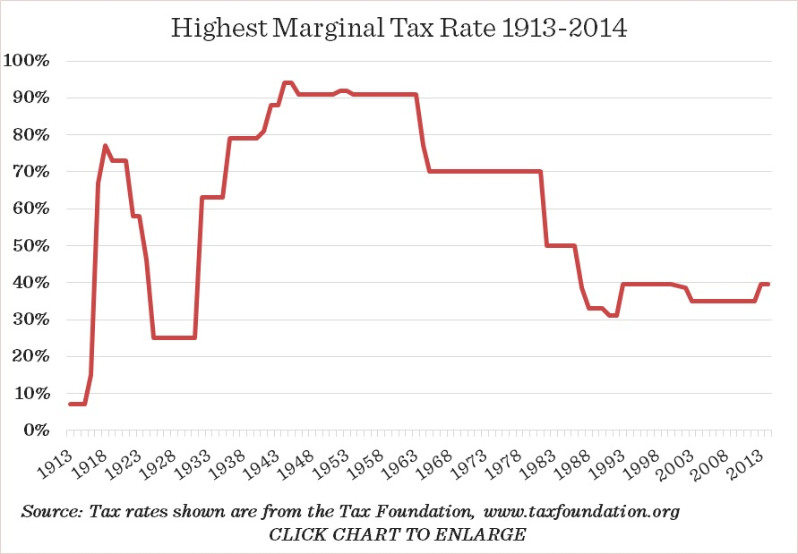
WHAT DIRECTION DO YOU THINK FUTURE TAX RATES ARE GOING TO GO?
Notes:
As can be seen from this historical tax-rate chart, we are currently in one of the lowest income tax environments in our history.
So what direction do you think tax rates are going to go?

Slide 15


REAL WORLD SITUATION
Pic
MARK
Pic
BETH
Their Needs
  Financial protection in the event of:
    death, or
    illness
  Cash accumulation that may be used for:
    emergencies,
    future college expenses, and
    retirement income
  Married, both age 35
  Have an 8-year-old daughter
For Agent Use Only-Not For Use With The Public
Notes:
Slide 3
Script:
Let’s look at a scenario…
Mark & Beth have been planning and saving for a long time for that day when they retire. Mark has a 401k at work into which he has been contributing the maximum amount for many years. By retirement day, Marks 401k has grown into a sizeable nest egg. So consider this…
If Mark and Beth knew exactly when they were going to die, they’d know exactly how and when to spend their money, right? Sure, that would be easy, but the problem is that they don’t know. None of us knows when we’re going to die.
Because they don’t know how long they’ll live, they’ll do what most retirees typically do, which is to live off the earnings of their nest egg because they know if they dip into the principal too much, they’ll erode their savings and potentially run out of money. As a result, they end up with a much lower standard of living.

Slide 16
A SOLUTION:
They purchase an Indexed Universal Life policy on Mark
FlexLife Indexed Universal Life Insurance
Policy Assumptions:
$1,000,000 IUL Option A Face Amount; Age 35 Male; Standard Non-Smoker; $950 check-o-matic monthly premium.
Premium paid all years except in years of withdrawals, ABR benefit distribution and receipt of LIBR benefit.
Illustrated Rate 7%; S&P 500 Point-to-Point Index Strategy
LSW FlexLife and all applicable riders are issued and underwritten by Life Insurance Company of the SouthWest. NL FlexLife and all applicable riders are issued and underwritten by National Life Insurance Company. Riders are optional, may be available at additional cost, and may not be available in all states or on all products. Values on the following slides are based on an assumed crediting rate of 7% annually. The benefit and values shown are not guaranteed. Actual results may be more or less favorable.
Notes:
Read Slide

Slide 17
LIFE STAGE 1 – FAMILY PROTECTION
Death Benefit protection to replace income in the event Mark dies prematurely.
  Policy provides $1,000,000 Death Benefit protection on Mark
  Cash value grows tax-deferred
In years 11 through 14 they take tax-free withdrawals of $5,000 per year to help with daughter’s college expenses.
Policy loans and withdrawals reduce the policy’s cash value and death benefit and may result in a taxable event. Surrender charges may reduce the policy’s cash value in early year. Withdrawals up to the basis paid into the contract and loans thereafter will not create an immediate taxable event, but substantial tax ramifications could result upon contract lapse or surrender.
Notes:
To address their concern about replacing Mark’s income in the event of a premature death, their policy has a $1,000,000 Death benefit.
Additionally, the policy offers the opportunity to grow cash value tax-deferred.
When their son entered college, they were able to take tax-free withdrawals of $5,000 a year to help with the college expenses.

Slide 18
LIFE STAGE 2 – ILLNESS
20 years later, Mark is diagnosed with Multiple Sclerosis
Uses ABR Chronic Benefit to replace lost wages and to make home improvements to accommodate his illness.
$40,000 ABR Benefit
each year for three years
Receipt of accelerated benefits will reduce the policy’s cash value and death benefit, may result in a taxable event, and may affect the client’s eligibility for public assistance programs. Reducing policy values too much may reduce or eliminate other rider benefits.
Notes:
20 years after they purchased the policy on Mark, he is diagnosed with Multiple Sclerosis.
Devastated, Mark worries how he will afford to keep up with the costs of treatment, medications and the home modifications he will need to make.
Fortunately, Mark added ABR to his policy when he purchased it. This gives him the option to exercise the rider to help meet these expenses.
He decides to accelerate a portion of the DB, each year over the next three years to help cover expenses.

Slide 19
LIFE STAGE 3 - RETIREMENT INCOME
At 65, Mark decides to exercise the Lifetime Income Benefit Rider.
Once elected, lifetime income payments – guaranteed!
Supplements other sources of retirement income: 401(k), Annuity and Social Security
Annual LIBR Benefit
(based on current assumptions)
$27,000
Exercising the rider results in loans and withdrawals against the policy, reducing the death benefit and cash surrender value, but will never reduce the death benefit to less than $15,000, nor the cash surrender value to less than $1,000. Exercising the rider may terminate other riders or reduce their benefits. Insufficient policy values or outstanding policy loans may also restrict exercising the rider. There is a charge during the benefit period. Guarantees are dependent upon the claims-paying ability of the insurer.
Notes:
At 65, Mark decides to exercise LIBR.
He wants to ensure that they get the most out of their retirement while also guaranteeing they won’t outlive their retirement income.
Mark decides to elect the monthly income benefit, which he will use to supplement other sources of retirement income such as his 401(k) and Social Security.
Once elected, the LIBR benefit is guaranteed for life.

Slide 20
THE FINAL EVENT
MARK PASSES AWAY

The remaining death benefit is paid to Beth

She is financially secure and her income needs are met

Beth helps with their grandchildren’s college expenses
Mike passes at age 80
$325,000
Death Benefit
Notes:
Mark passes away at age 80. His remaining death benefit has provided Beth financial security and she was also able to use some of the money to help with the grandchildren’s college expenses.

Slide 21
PREMIUMS PAID vs. BENEFITS RECIEVED
Total Premium Paid $ 262,200
Withdrawals for College $ 20,000
ABR Benefits $ 120,000
LIBR Benefits $ 405,000
Remaining Death Benefit $ 325,000
        $ 870,000
Total Net Benefit $ 607,800
Based on an illustrated rate of 7% for all years of the policy. This is not guaranteed. At the guaranteed rate of 2.5%, the policy is unable to support any withdrawals.

Slide 22



PROTECTING EVERY STAGE OF LIFE
By purchasing a permanent policy in his early Thirties, Mark was able to:
  Provide for his family should he die prematurely, and help fund his daughter’s college education.
  Accelerate a portion of the DB to help meet costs associated with his MS.
  Guarantee lifetime income benefit payments to supplement his retirement.
  Provide an ongoing legacy to his Grandchildren
Notes:
When Mark purchased his policy, he and his wife had no idea that it would be able to provide as much as it did for them!

Slide 23
ADVANCED MARKETS
ADVANCED MARKETS
PETE LEE, RICP®
DIRECTOR OF ADVANCED MARKETS
plee@equisfinancial.com
BILL MARTIN 2.0
DIRECTOR OF MARKETING
wmartin@equisfinancial.com
For Agent Use Only – Not For Use With The Public

Slide 24
FOR BANK / FINANCIAL INSTITUION USE ONLY – NOT FOR USE WITH THE PUBLIC
Notes:
(Please conclude by delivering this very important message)
As you can see, we have quite a story but the great thing is it’s a simple one….
The National Life Group is a national company comprised of passionate people who care about the needs of their customers. While we represent different products, different issuing companies, and operate across all the geographies and cultures of the U.S., we are at the core a single company that has delivered on its promises for 166 years.

