Slide 1
RETIREMENT BATTLE
#1
The Battle of Inflation

Slide 2
RETIREMENT BATTLE
#1
Winning the Battle of Inflation
A First Class Stamp
$.13 cents¹
A Gallon of Gasoline
$.59 cents²
1976
41 YEARS
¹ US Postal Service
² Flashback 1970’s
$.49 cents¹
$2.19
2017

Slide 3
RETIREMENT BATTLE
#1
Winning the Battle of Inflation
The "Rule of 72" is a financial rule of thumb that can help you compute your money growth at a given interest rate.
It's called the rule of 72 because at 10%, money will Double every 7.2 years.

Slide 4
RETIREMENT BATTLE
#1
Winning the Battle of Inflation
If you invest $1000 at 3% interest, it will Double in 24 years because 72 divided by 3 equals 24

Slide 5
RETIREMENT BATTLE
#1
Winning the Battle of Inflation
If you invest $1000 at 12% interest, it will Double in 6 years because 72 divided by 12 equals 6

Slide 6
RETIREMENT BATTLE
#2
The Battle of Taxes

Slide 7
FACTS ABOUT NATIONAL DEBT
$23,162,440,797,000.00
“OFFICIAL” US DEBT AS OF 1/6/20
“OFFICIAL” US DEBT AS OF 6/20/18
$21,162,500,797,000.00
“OFFICIAL” INCREASE IN 1.5 YEARS
$2 TRILLION
“REAL” NATIONAL DEBT
$210,574,150,562,000.00
YOUR SHARE OF THE REAL US DEBT
$654,205.00
For Agent Use Only – Not For Use With The Public
Notes:
$14,283,376,782,000.00 – “Official” US National Debt as of 4/9/11¹
$12,382,762,615,000.00 – “Official” US Debt as of 2/5/10¹
1.9 trillion increase in 14 months
The Real National Debt is $76,787,100,562,000.00
Why is it the Real Debt? In a May 19, 2008 USA Today article (http://www.usatoday.com/news/washington/2008-05-18-Redink_N.htm) it explains that “Accounting standards require corporations and state governments to count new financial obligations, even if the payments will be made later. The federal government doesn't follow that rule. Instead of counting lifetime benefits for programs such as Social Security, the government counts the cost of benefits for the current year.” This is why there is such a discrepancy between the “official” debt and the “real” debt.
Your share of the real debt is: $200,000
The national debt has increased an average of $3.71 billion per day 9/28/2007
Let me give you an example of how much money that is. If you took 1,000,000 in hundred dollar bills and stacked them on top of one another the pile would be 61/2 feet high.
If you took the same thing with a billion dollars the stack would be 67 feet tall.
If it were a trillion it would be 1,260 miles tall. [insert an example from city to city]
To spend a trillion dollars you would have to spend 1.3 million a day for over 2,000 years.
Source: US National Debt Clock: www.brilling.com/debt_clock

Slide 8
HOW
BIG IS A TRILLION?
WHAT YEAR WAS IT
1 TRILLION SECONDS AGO?
1
DAY
86,400
SECONDS
1
YEAR
31,536,000
SECONDS
YOU COULD SPEND $31.5 MILLION A YEAR FOR 32,000 YEARS
JUST TO SPEND
$1 TRILLION
31,688
YEARS
1,000,000,000,000
SECONDS
ANSWER: 30,000 B.C.
For Agent Use Only – Not For Use With The Public
Notes:
What year was it 1 trillion seconds ago? [Answer 30,000 B.C)
Let’s talk about the debt for a minute. So right now if you go to the web and search national debt. You are going to see an official national debt of just over $13 trillion. Let me put it into perspective how big a trillion is. I picked up one of my kids from school last year and on the way home they said, hey dad, do you want to know how big a trillion is? And I was like, of course I do, you know I talk about this. And he said, well, dad, guess what year it was one trillion seconds ago. Ah, I don’t know. He said well take a guess. Oh, buddy, 1400? Dad, that’s awful, terrible, dad, because you can do better than that. Well, I went home and I did some math. So write these numbers down.
86,400 seconds = one day (math: 60 seconds in one minute x 60 minutes in one day = 3,600 seconds x 24 hours in one day = 86,400 seconds)
31,536,000 seconds = one year (math: 86,400 seconds in one day x 365 days in one year = 31,536,000 seconds)
One trillion seconds is 31,688 years. That takes you all the way back to prehistoric times.
And we throw a trillion around in dollars around like it is nothing.

Slide 9
FACTS ABOUT NATIONAL DEBT
For Agent Use Only – Not For Use With The Public
Notes:
Where is all this debt coming from?
A few examples:
The stimulus packages
Social Security: In 2017 we will begin paying more in benefits than we collect in taxes. Without changes, by 2041 the social security trust fund will be exhausted*. There will only be enough money to pay about 75 cents for each dollar of scheduled benefits. We need to resolve these issues soon to make sure social security continues to provide a foundation for protection for future generations.

Slide 10
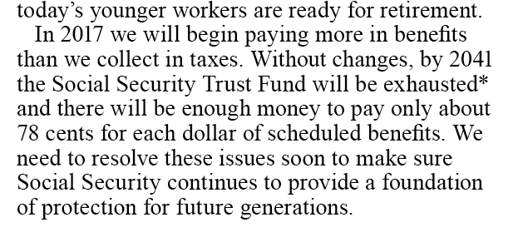
FACTS ABOUT NATIONAL DEBT
For Agent Use Only – Not For Use With The Public
Notes:
Where is all this debt coming from?
A few examples:
The stimulus packages
Social Security: In 2017 we will begin paying more in benefits than we collect in taxes. Without changes, by 2041 the social security trust fund will be exhausted*. There will only be enough money to pay about 75 cents for each dollar of scheduled benefits. We need to resolve these issues soon to make sure social security continues to provide a foundation for protection for future generations.

Slide 11
THERE ARE ONLY TWO WAYS TO COMBAT THE GROWING DEBT
1. SPEND LESS
2. TAX MORE
For Agent Use Only – Not For Use With The Public
Notes:
There are only two ways to combat this growing debt…
Spend less, or
Tax More
[solicit feedback]
Do you feel like you have no control?

Slide 12
ARE WE SPENDING LESS
AS A GOVERNMENT?
NO
For Agent Use Only – Not For Use With The Public
Notes:
Do you think we are spending less as a government?
Solicit feedback
No…we are spending more than we ever have in the history of our country.

Slide 13
WE ARE SPENDING MORE THAN WE EVER HAVE IN THE HISTORY OF OUR COUNTRY
SOLUTION:
MORE
TAXES
For Agent Use Only – Not For Use With The Public
Notes:
Do you think we are spending less as a government?
Solicit feedback
No…we are spending more than we ever have in the history of our country.

Slide 14
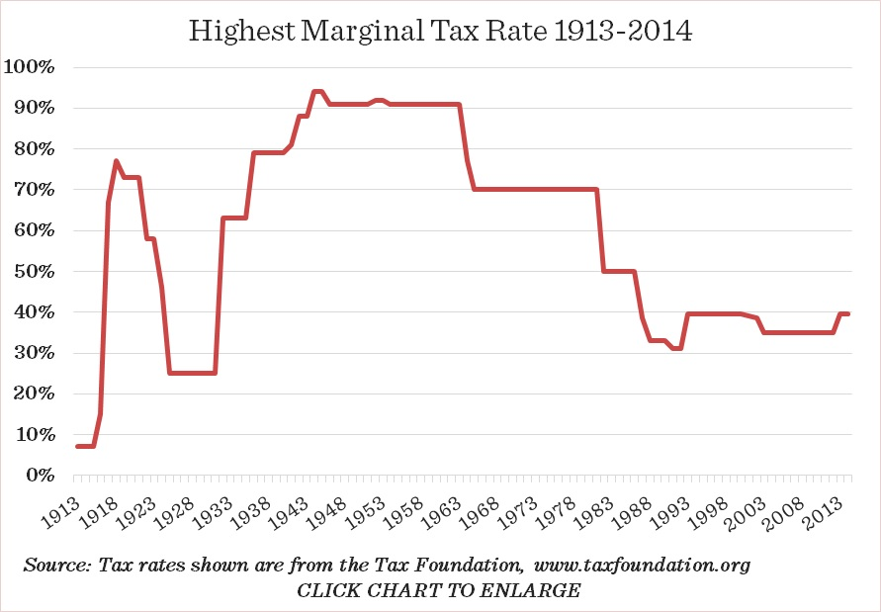
WHAT DIRECTION DO YOU THINK FUTURE TAX RATES ARE GOING TO GO?
2nd Worst Financial Crisis in History
Taxes High for 50 Years
Stock Market Crash – 25%
Average is 62.1%
DOES IT MAKE SENSE TO DEFER YOUR TAXES?
For Agent Use Only – Not For Use With The Public
Notes:
As can be seen from this historical tax-rate chart, we are currently in one of the lowest income tax environments in our history.
So what direction do you think tax rates are going to go?

Slide 15
WAYS TO SAVE
AFTER
TAX
PRE
TAX
TAX DEFERRED
TAX FREE
For Agent Use Only – Not For Use With The Public
Notes:
After Tax Strategy – is when you set aside a portion of your after tax income into an account earmarked for retirement. Taxes are paid annually on any earnings. An example of this type of savings is a Certificate of Deposit.
Pre-Tax Strategy – might include a qualified plan sponsored by your employer, like a 401(k) plan. You don’t pay current taxes on contributions made to the plan, and earnings grow tax-deferred.
Tax-Deferred Strategy – is when you set aside a portion of your after tax income for retirement, earnings on the account grow tax-deferred. A Non-deductible IRA or an annuity are examples of this type of savings.
Tax-Free Strategy - is similar to a Tax-Deferred Strategy: you set aside a portion of your after tax income, and earnings grow tax-deferred. If all the requirements are met, then the earnings can be taken out retirement free from Federal income taxes. A Roth IRA is an example of this type of savings.

Slide 16
TYPES OF RETIREMENT INCOME
TAXABLE
CAPITAL GAINS
ORDINARY
EARNINGS ON:
INCOME FROM:
STOCKS
MUTUAL FUNDS
SALE OF BUSINESS INTERESTS
REAL ESTATE
WAGES & INTEREST
SOCIAL SECURITY
IRA, SEP, SIMPLE
401(k), 403(b)
For Agent Use Only – Not For Use With The Public
Notes:
Let’s take a look at some different sources of retirement income.
When you retire, all of your money will be in one of two pots as I like to call them – either Taxable or Tax-Free.
If you could choose which pot you’d like to have the most money it, which one would you prefer? Taxable or Tax-Free? (Let them actually answer this question – very important.)
We’re going to look at the taxable side first. This pot can be divided into two different types of tax. The first kind is called Capital Gains Tax. Some of the things that fall into this category are: Stocks, Mutual Funds, Investment Real Estate, and the Sale of a Business. For those items, if you have owned them longer than 12 months, when you sell them, you currently only pay 15% on the profit. Now this rate can change and probably will, but for now, that’s the tax rate.
The other side of this pot is something you are VERY familiar with – Income Tax.
QUESTION TO ASK: “Let me ask you, do you think tax rates are going to be higher or lower in the future?” (Again, wait for an answer. Nearly 100% will say higher.)
I agree. I think there are a lot of reasons for that to be the case, and we are already seeing the top tax rate going from 35% to just under 40%. However, no one knows what that will look like, so let’s just assume a 40% rate for now.
What things fall into that category?
First, any income you continue to earn – including 1099 interest.
Second, even Social Security can now be subject to Income Tax.
But most of the things that fall into that category are what I like to call the Alphabet Soup of Retirement: IRA, SEP, Simple, 401(k), 403(b), etc. Anything that is classed as a Tax-Qualified Retirement Plan.
When the money went into these accounts you didn’t pay tax on it; however, when it comes out … all of it … both contribution AND gain will be taxed at whatever the income tax rate is at that time.

Slide 17
TYPES OF RETIREMENT INCOME
TAX-FREE
MUNICIPAL BONDS
ROTH IRA
LIFE INSURANCE CASH VALUE
*Policy loans and withdrawals reduce the policy’s cash value and death benefit and may result in a taxable event. Withdrawals up to the basis paid into the contract and loans thereafter will not create an immediate taxable event, but substantial tax ramifications could result upon contract lapse or surrender. Surrender charges may reduce the policy's cash value in early years.
Overfunding a permanent life insurance policy creates the risk that the policy will become what is known as a Modified Endowment Contract (MEC.) For MECs, contract loans and withdrawals are considered taxable income.
For Agent Use Only – Not For Use With The Public
Notes:
Now, let’s look at what falls into the Tax-Free Pot.
There are 3 places that I’m aware of that you can put money and access it tax-free.
The first one is Municipal Bonds.
The second one is the Roth IRA
And the third is certain types of Life Insurance.
I tend to cross off Municipal Bonds for everyone for two reasons. First, over time, Municipal Bonds have barely kept pace with inflation. And second, Muni Bonds by themselves are not very well diversified.
IF CLIENT IS HIGH INCOME EARNER AND CAN’T CONTRIBUTE TO A ROTH DUE TO INCOME, SAY:
In your case ____(name)_____ we have to cross off the Roth IRA, because the government, in their great wisdom, has decided that you make too much money and therefore, don’t qualify.
So, in your case, the only place that you are able to get money into the Tax-Free Pot is Life Insurance … but it just so happens that’s really good option.
IF CLIENT CAN CONTRIBUTE TO A ROTH IRA, SAY:
So in your case, you can contribute to both a Roth IRA and Life Insurance … and they’re both a really good options.

Slide 18
QUESTION:
If you were doing the wrong thing to prepare for your retirement, when would you like to know about it?
Now? … Or when you retire?
For Agent Use Only – Not For Use With The Public
Notes:
Now, let me ask you a question? If you were doing the wrong thing for your retirement, when would you like to know about it…now, or when you retire?
Now, of course… (Click)

Slide 19
SMART RETIREMENT MONEY ORDER
1
FREE MONEY
2
TAX-FREE MONEY
3
TAX-DEFERRED MONEY
4
TAXABLE MONEY
For Agent Use Only – Not For Use With The Public
Notes:
Here’s the types of money available in retirement.

Slide 20
SMART RETIREMENT MONEY ORDER
1
FREE MONEY
Inherited
Matching 401(k) Money
2
TAX-FREE MONEY
3
TAX-DEFERRED MONEY
4
TAXABLE MONEY
For Agent Use Only – Not For Use With The Public
Notes:
What kind of money is non-earned? An inheritance, lottery winnings, and employee matched contributions to a 401(k). Of course, you always want to take advantage of any “free” money. That goes especially for making sure you are contributing to your employer’s retirement plan to take full advantage of any matching money they will contribute to your account.

Slide 21
SMART RETIREMENT MONEY ORDER
1
FREE MONEY
2
TAX-FREE MONEY
Roth IRA
Life Insurance Cash Value*
3
TAX-DEFERRED MONEY
4
TAXABLE MONEY
*Policy loans and withdrawals reduce the policy’s cash value and death benefit and may result in a taxable event. Withdrawals up to the basis paid into the contract and loans thereafter will not create an immediate taxable event, but substantial tax ramifications could result upon contract lapse or surrender. Surrender charges may reduce the policy's cash value in early years.
For Agent Use Only – Not For Use With The Public
Notes:
Now, let’s take a look at tax-free money. Please be aware these aren’t the only vehicles that can potentially provide tax-free income, but they are ones we work with every day.
Roth IRAs: Good choice……if you qualify. In 2009, in order to contribute to a Roth IRA your adjusted gross income must be below $166,000 if married filing jointly, and is phased out totally at $176,000. If you’re single, it’s $105,000 and is phased out at totally at $120,000. Contributions are limited to $5,000 per person unless you’re 50 or older and then you can contribute an extra $1,000 as a catch up provision.
There are times when it may be in your best interest to explore the possibility of converting your traditional tax qualified (taxable) IRA to a Roth IRA (tax-free). There are current tax consequences to this move and only after careful consideration with your advisor and tax planner should this option be considered.
With that being said, In 2010 there is a one-year window that may be more favorable for this move where you will be able to spread the tax over two years, and there is no income limit on the conversion. If you’d like more information on this please arrange for a complimentary consultation at the end of this workshop.
Universal Life Insurance Cash Value: If you need life insurance, or have the desire to leave a legacy this may provide an ideal solution. Your income that you use for the premium would have already been taxed, and through the use of loans you can potentially receive tax-free income if the policy is correctly structured. Certain policies offer interest you earn on your cash value equal to the interest the loan costs you so you have a zero net cost for the loan. The plan is also self-completing in the event of disability or death, meaning that the death benefit or other benefits provided by riders would help fund your family’s goals.
[note to presenter – if you are asked about municipal bonds and you don’t hold either a series 7 or investment adviser representative registration, indicate that you can have a colleague who is licensed to discuss these investments call them and answer their questions.]

Slide 22
SMART RETIREMENT MONEY ORDER
1
FREE MONEY
2
TAX-FREE MONEY
3
TAX-DEFERRED MONEY
Annuities
Tax-Qualified Plans such as 401(k), IRA, etc.
4
TAXABLE MONEY
For Agent Use Only – Not For Use With The Public
Notes:
Tax-deferred money is where most Americans accumulate retirement dollars. And this is where the sleeping giant lies. You are secretly growing your own future tax bill.
There are great benefits to these types of savings plans. If it wasn’t for employer-sponsored retirement plans, many people wouldn’t have any retirement savings.
But, as with many silver linings, there’s a dark cloud…..
The logic that motivates people to put money in tax qualified plans is current tax deduction with the thought that at retirement you will be in a lower tax bracket. Although the concept sounds good where do you think taxes are going to be when you take distributions from these accounts? And with qualified plans, after age 70 ½ you are required to begin taking minimum distributions and pay the tax on them.
Annuities are also long-term retirement vehicles offered by insurance companies. The earnings are tax-deferred until they are distributed, and are taxed as ordinary income.

Slide 23
SMART RETIREMENT MONEY ORDER
1
FREE MONEY
2
TAX-FREE MONEY
3
TAX-DEFERRED MONEY
4
TAXABLE MONEY
Wages
Capital Gains
1099 Interest
For Agent Use Only – Not For Use With The Public
Notes:
Taxable money:
Wages
Capital gains
1099 interest
Just like the weather, everyone complains about taxes, but with some taxes there’s little you can do about them…the government will always take theirs. However, the good thing about these taxes, it means you made money. Is anyone here willing to take a $1,000 cut in pay in order to save $300 on taxes? Of course not! But when it comes to your retirement, if there are options to reduce your taxes in a smart way, would you want to know about it?

Slide 24
SMART RETIREMENT MONEY ORDER
1
FREE MONEY
2
TAX-FREE MONEY
3
TAX-DEFERRED MONEY
4
TAXABLE MONEY
Any contribution above the match of your 401(k) becomes
tax-deferred money, and skips over #2 completely
For Agent Use Only – Not For Use With The Public
Notes:
Here’s the types of money available in retirement.

Slide 25
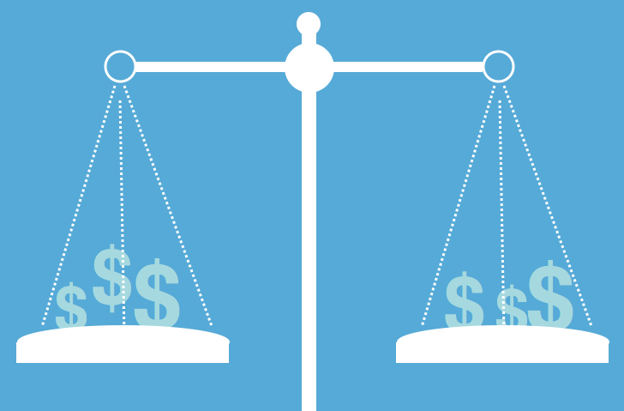
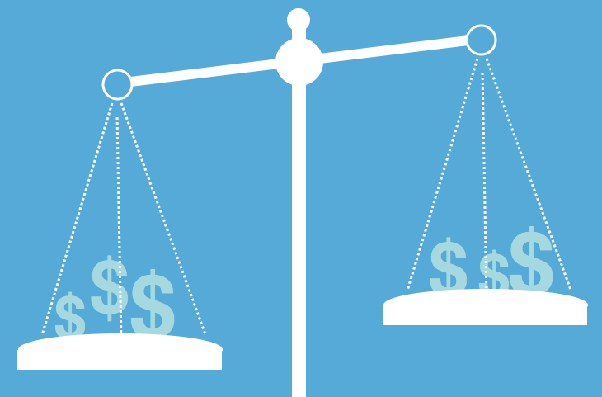
LET’S TAKE A LOOK AT THE DIFFERENCE BETWEEN A TAX-DEFERRED PLAN AND A TAX-FREE PLAN
For Agent Use Only – Not For Use With The Public

Slide 26
Tax-Qualified Strategy vs. Tax-Free Strategy
Tax-Qualified Strategy
Tax-free Strategy
{
Gains
{
100% taxed as income upon withdrawal
Accessible tax-free
if done properly
{
Taxed prior to contribution
0
Tax
Tax-deferred contribution NO TAX PAID
Tax-free contribution TAXES PAID
{
On this?
Or this?
Would you rather pay taxes
For Agent Use Only – Not For Use With The Public
For Agent Use Only – Not For Use With The Public
Notes:
The money that has gone into your 401(k), did you pay tax on that before it went in? No. That’s right. Zero taxes, but because you paid zero tax on the money going in, when you take it out, all of it, both the contribution and gain, 100% of it is going to be taxed at whatever the current tax rate is at the time you withdraw the money. On the other side of the equation, the money that goes into that type of account, it already has been taxed. So if you earned the money, you pay taxes on it and then you put it in here. But because the way the rules are written on that if done properly, you are taxed on the money going in, if you do it right, you are able to access your cash and pay zero tax upon withdrawal.

Slide 27
QUESTION:
When you put your money into an IRA or 401(k),
are you really saving tax?
No. Simply delaying tax.
Which actually compounds the tax problem.
For Agent Use Only – Not For Use With The Public

Slide 28
RETIREMENT BATTLE
#3
The Battle of Your Health

Slide 29
What Can Happen to You?
You may become Terminally or Critically Ill
HEART ATTACK
About every 34 seconds, someone in the United States has a
myocardial infarction (heart attack).¹
STROKE
On average, a stroke occurs every 40 seconds.²
CANCER
A new cancer is diagnosed every 30 seconds in the United States.³
1 in 2 men and women will be diagnosed with cancer in their lifetime.⁴
^{1.} About Heart Attacks” American Heart Association. 12 June 2011. http://www.heart.org/HEARTORG/Conditions/HeartAttack/AboutHeartAttacks/About-Heart-Attacks_UCM_002038_Article.jsp (24 April 2012).
^{2.}“Impact of Stoke” American Stoke Association. 18 April 2012. http://www.strokeassociation.org/STROKEORG/AboutStroke/Impact-of-Stroke_UCM_310728_Article.jsp (24 April 2012).
^{3.} “Cancer Facts & the War on Cancer” National Cancer Institute. 2012. http://training.seer.cancer.gov/disease/war/ (24 April 2012).
4. “SEER Stat Fact Sheets: All Sites” National Cancer Institute. 2012. http://seer.cancer.gov/statfacts/html/all.html (25 April 2012).

Slide 30
48 - 48 - 60 What do these numbers mean?
48% of mortgage foreclosures are the result of financial hardship due to critical Illness (only 3% due to death).¹
48% of businesses that fail, fail because of a critical illness.²
60% or more of all bankruptcies are directly tied to medical conditions such as critical illnesses, and around 80% of the individuals were already covered by health insurance.³
^{1.} Get Sick, Get Out: The Medical Causes of Home Foreclosures" Health Matrix, 2008.
^{2.} Goldstein, Mark, “Critical Illness Insurance 101” http://ezinearticles.com/?Critical-Illness-Insurance-101&id=4450375 (13 April 2012).
^{3.} “More People are Surviving Critical Illnesses…” United States Critical Illness Insurance Resource Center, 2012. http://criticalillnesspolicies.com/insurance-coverage/critical-illness-statistics/ (13 April 2012).
Notes:
Read slide

Slide 31
What normally happens when you suffer a Critical or Chronic Illness?
EXPENSE
INCOME
Notes:
This example that shows what may happen when you experience a chronic or critical illness. Everyone’s goal in life is to have their income higher than their expenses. Two things may happen when you have a chronic or critical illness. One is that your income goes down. You are going to have time off of work and you will need time to recover. The second thing that may happen is that you will have increased expenses. Even if you have the best health insurance policy available, you will have co-pays and deductibles and possibly medicine that health insurance will not cover. So what ends up happening is that you create debt or spend your savings.
The beauty of the living benefits is that the insured has access to benefits to help offset the increased expenses and decreased income. This in turn in most cases allows you to keep the gap between your expenses and your income.

Slide 32
Income vs Expenses
Additional Income
From Living Benefits!!!
Your Family’s Income
DEBT
Time Off Work
Your Family’s Expenses
Recovery Time
Deductibles
Co-Pays
Notes:
This example that shows what may happen when you experience a chronic or critical illness. Everyone’s goal in life is to have their income higher than their expenses. Two things may happen when you have a chronic or critical illness. One is that your income goes down. You are going to have time off of work and you will need time to recover. The second thing that may happen is that you will have increased expenses. Even if you have the best health insurance policy available, you will have co-pays and deductibles and possibly medicine that health insurance will not cover. So what ends up happening is that you create debt or spend your savings.
The beauty of the living benefits is that the insured has access to benefits to help offset the increased expenses and decreased income. This in turn in most cases allows you to keep the gap between your expenses and your income.

